Slide 1

Lab 1
Group_D:
Laurice Sattouf
Choi Tim Anthony Young
Dimitri Garcia
Professor:
Mohamed El-Hadedy
California Polytechnic State University Pomona, California

Slide 2
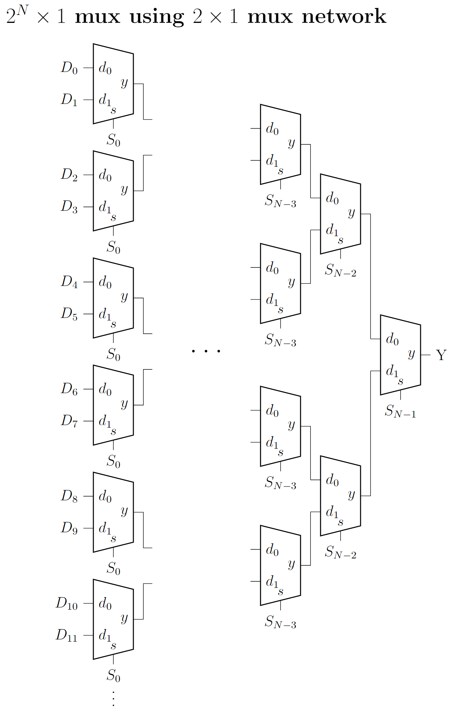
Assignment
Implementing Mux64X1 using Generic, Mux2x1 network and for loop in VHDL.
This figure is showing the circuit of the implemented design.

Slide 3
Coding Steps
Mux2x1 entity created.
MuxNx1 entity created. Using “generic “ allows us to change the size of the mux to the desired value of N.
Using the “for generate” in the RTL allows to generate all the components of Mux2x1 needed.
As seen in the schematic, we need to define the select choice in every level:
#of levels = log2(N).
The levels where generated using a nested for loop.

Slide 4
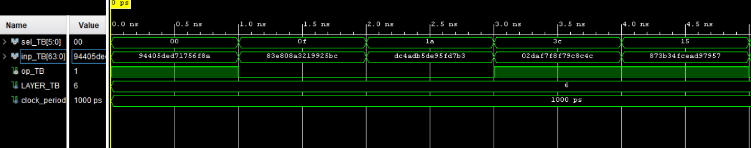
Test Bench Results:

Slide 5
Power and Resources

Slide 6

Work Distribution
We all worked individually on the code and then we had a discussion session to combine all the work.
We had a zoom meeting to demo and cover all the corner cases.
Documentation and reports were evenly distributed, and it covered all the steps of our successfully implemented design.

